Slide 1
Module 4 Part 1: Feed Forward and Backpropagation Neural Networks
Samuel Kwon
FF and BP code

Slide 2
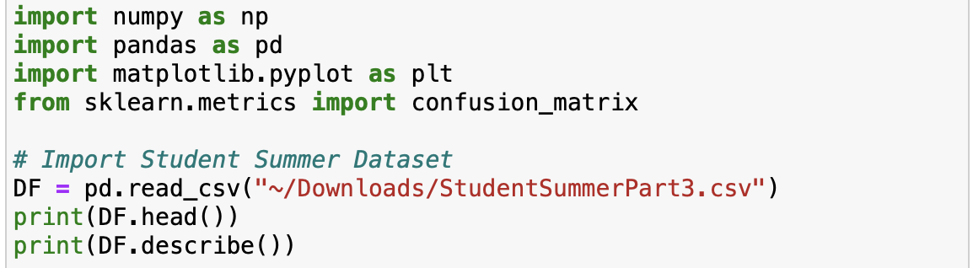
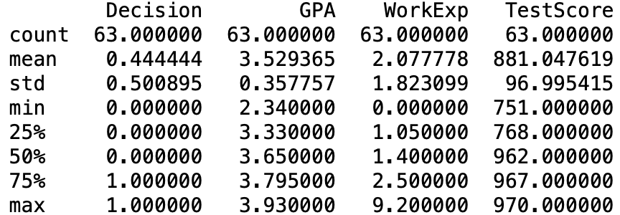
Initial Data Exploration
A feed forward neural network using backpropagation will be implemented to predict the decision (admit or decline) of a summer program.
- The pandas library is utilized to read in the Student Summer dataset. The dataset is explored by printing statistical parameters and the first few rows of the dataset. The decision label column is a discretized column where 1 represents admitted and 0 represented denied. A linear regression is performed with GPA, WorkExperince, and TestScore as predictors.

Slide 3
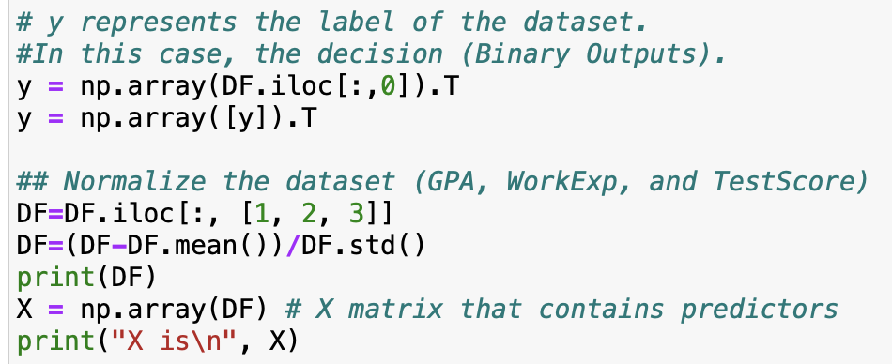
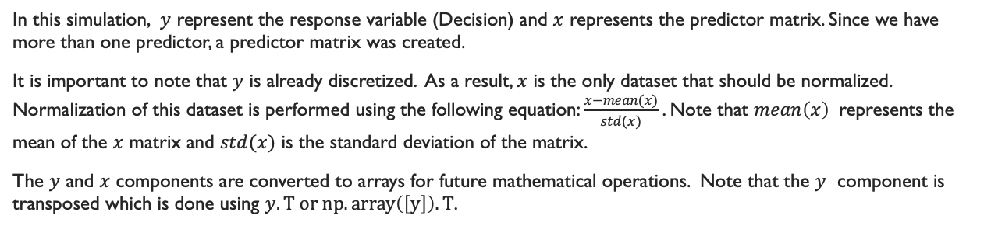
Data manipulation and Normalization
In this simulation, $y$ represent the response variable (Decision) and $x$ represents the predictor matrix. Since we have more than one predictor, a predictor matrix was created.
It is important to note that $y$ is already discretized. As a result, $x$ is the only dataset that should be normalized. Normalization of this dataset is performed using the following equation: $\frac{x−mean(x)}{std(x)}$. Note that $mean\left(x\right)$ represents the mean of the $x$ matrix and $std(x)$ is the standard deviation of the matrix.
The $y$ and $x$ components are converted to arrays for future mathematical operations. Note that the $y$ component is transposed which is done using $y.T or np.array\left(\left[y\right]\right).T$.

Slide 4
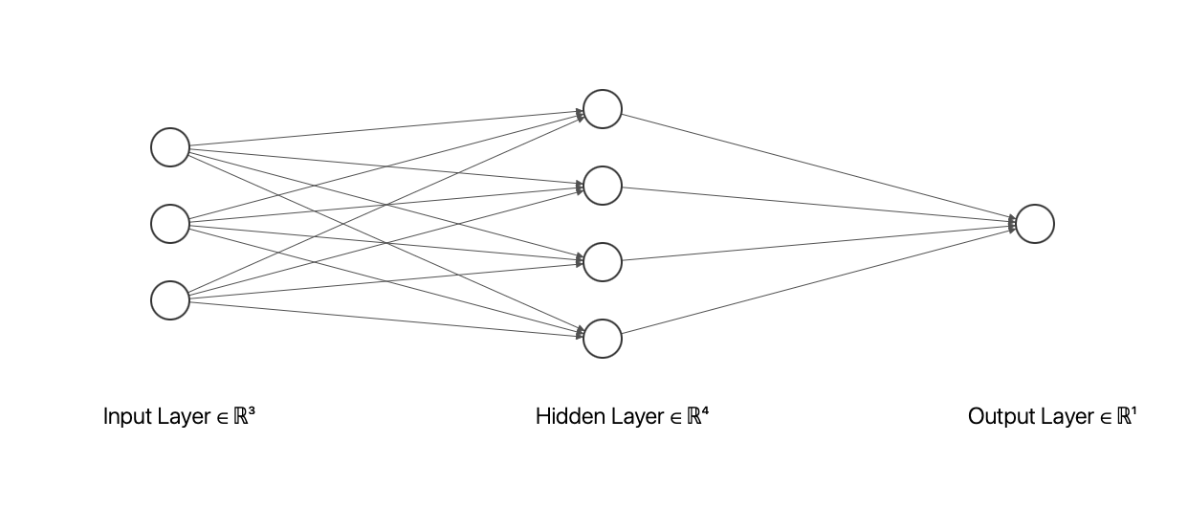
Neural Network Structure

Slide 5
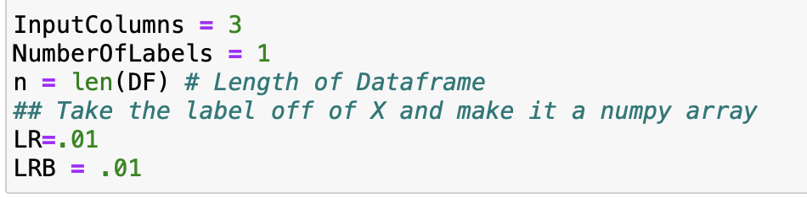
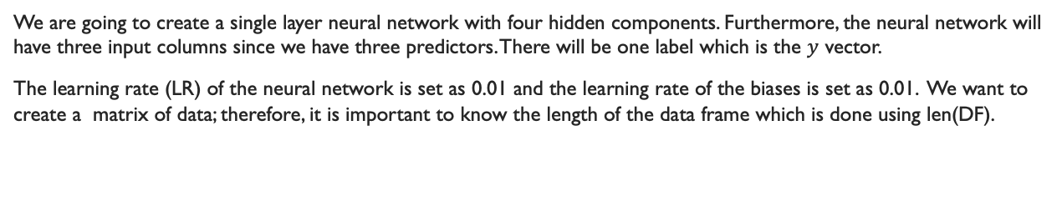
Neural Network Specifications
We are going to create a single layer neural network with four hidden components. Furthermore, the neural network will have three input columns since we have three predictors. There will be one label which is the $y$ vector.
The learning rate (LR) of the neural network is set as 0.01 and the learning rate of the biases is set as 0.01. We want to create a matrix of data; therefore, it is important to know the length of the data frame which is done using len(DF).

Slide 6
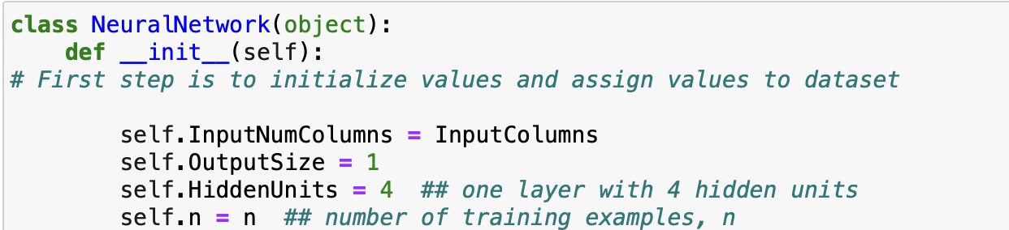
Neural Network Object and Initialization
To implement the feed forward and backpropagation neural network, we are going to create an object called neural network. In this class, the first step is to define values that will initialize the process. Self.InputNumColumns represents the number of columns of the dataset which was declared earlier during the specification process. Self.OutputSize represents the output of the neural network. In this case, we are going to output the predicted decision values. Self.HiddenUnits represents the number of units in the first hidden later. In slide four, we have a diagram of the neural network. In this, we can see four circles in the hidden layer. Self.n represents the length of the data frame or the number of rows where we can test the network.

Slide 7

Weight matrix and Bias
$$w_{1}=\left[\begin{matrix}w_{11} & w_{12} & w_{13} & w_{14} \\ w_{21} & w_{22} & w_{23} & w_{24} \\ w_{31} & w_{32} & w_{33} & w_{34}\end{matrix}\right]$$
$$w_{2}=\left[\begin{matrix}w_{1} \\ \begin{aligned}w_{2} \\ w_{3} \\ w_{4}\end{aligned}\end{matrix}\right]$$
$$b=\left[\begin{matrix}b_{1} & b_{2} & b_{3} & b_{4}\end{matrix}\right]$$
$$\begin{matrix}c=[\begin{matrix}c\end{matrix}]\end{matrix}$$

Slide 8
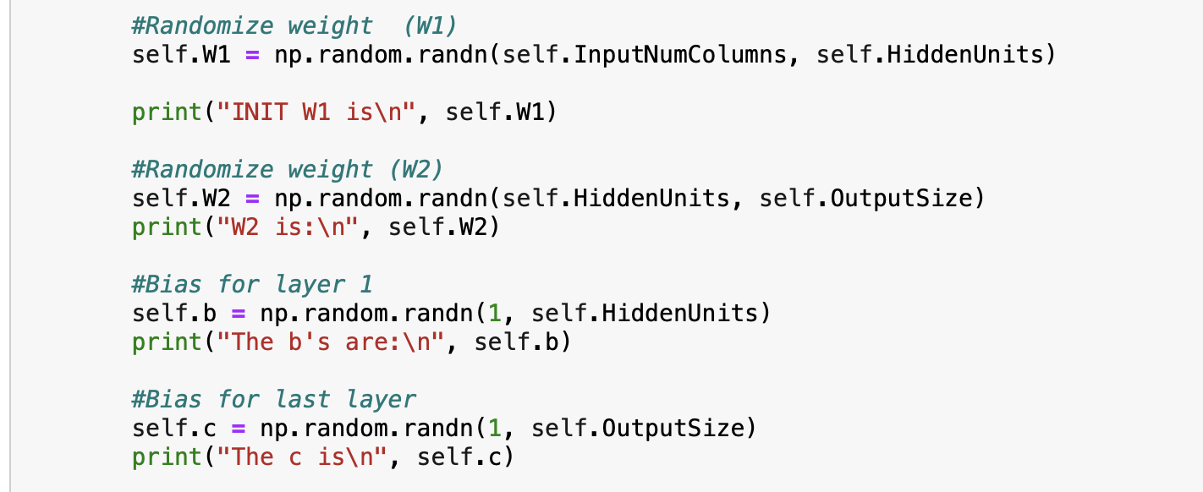
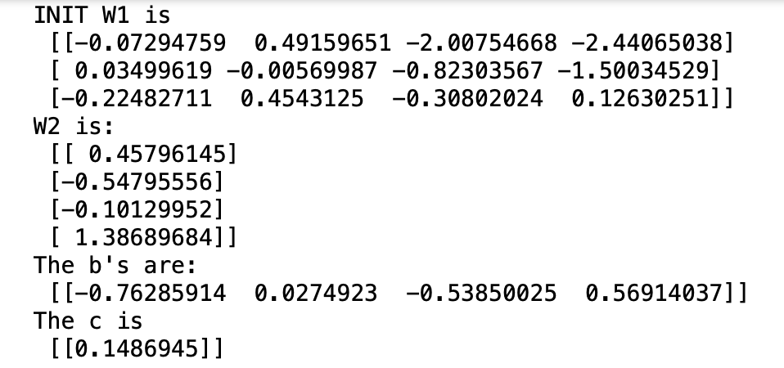
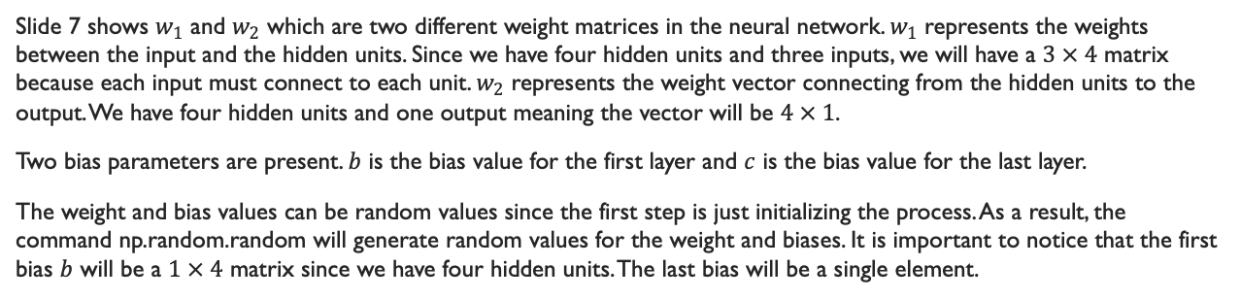
Weight Matrix and Bias
Slide 7 shows $w_{1}$ and $w_{2}$ which are two different weight matrices in the neural network. $w_{1}$ represents the weights between the input and the hidden units. Since we have four hidden units and three inputs, we will have a $3 × 4$ matrix because each input must connect to each unit. $w_{2}$ represents the weight vector connecting from the hidden units to the output. We have four hidden units and one output meaning the vector will be $4 × 1$.
Two bias parameters are present. $b$ is the bias value for the first layer and $c$ is the bias value for the last layer.
The weight and bias values can be random values since the first step is just initializing the process. As a result, the command np.random.random will generate random values for the weight and biases. It is important to notice that the first bias $b$ will be a $1 × 4$ matrix since we have four hidden units. The last bias will be a single element.

Slide 9
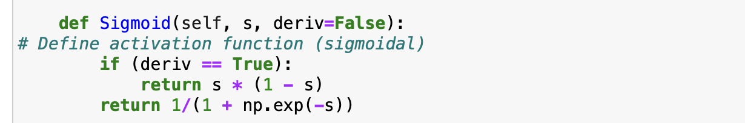
Activation Function
A sigmoidal activation will be applied to the values produced during Feed Forward and Backpropagation. The sigmoidal activation function is declared as a function where it takes in elements from self, s, and a condition if the derivative is true. In the case where the derivate is true, the function will return the evaluated value using the derivative of the sigmoidal function. Otherwise, it will return the value using the regular sigmoidal function.

Slide 10
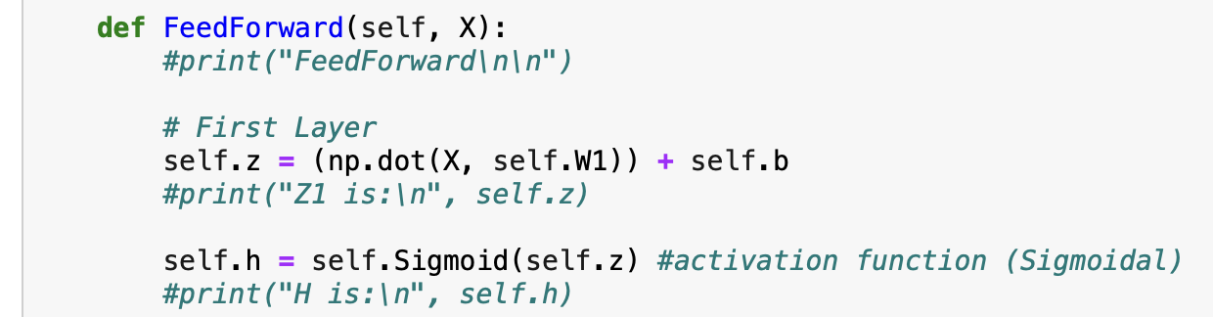
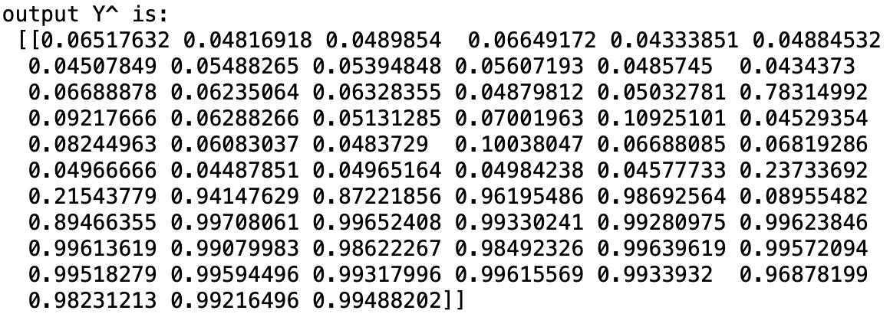
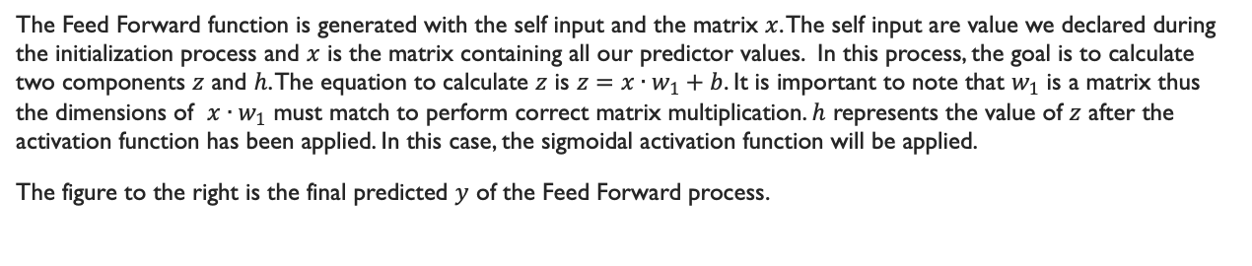
Feed Forward
The Feed Forward function is generated with the self input and the matrix $x$. The self input are value we declared during the initialization process and $x$ is the matrix containing all our predictor values. In this process, the goal is to calculate two components $z$ and $h$. The equation to calculate $z$ is $z=x∙w_{1}+b$. It is important to note that $w_{1}$ is a matrix thus the dimensions of $x∙w_{1}$ must match to perform correct matrix multiplication. $h$ represents the value of $z$ after the activation function has been applied. In this case, the sigmoidal activation function will be applied.
The figure to the right is the final predicted $y$ of the Feed Forward process.

Slide 11
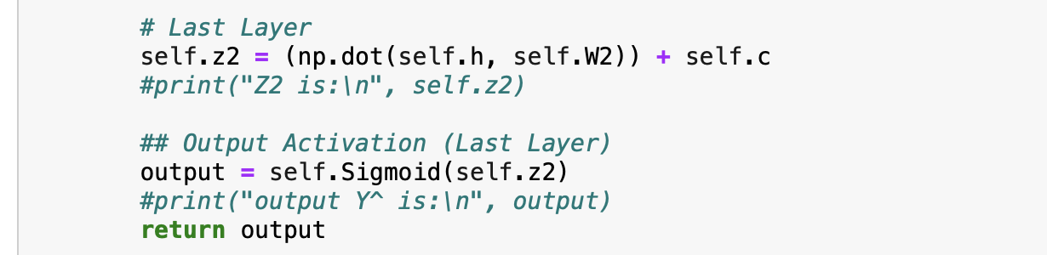
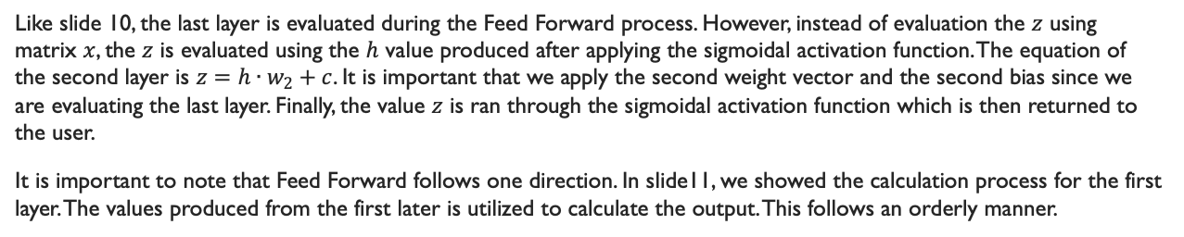
Feed Forward
Like slide 10, the last layer is evaluated during the Feed Forward process. However, instead of evaluation the $z$ using matrix $x$, the $z$ is evaluated using the $h$ value produced after applying the sigmoidal activation function. The equation of the second layer is $z=h∙w_{2}+c$. It is important that we apply the second weight vector and the second bias since we are evaluating the last layer. Finally, the value $z$ is ran through the sigmoidal activation function which is then returned to the user.
It is important to note that Feed Forward follows one direction. In slide11, we showed the calculation process for the first layer. The values produced from the first later is utilized to calculate the output. This follows an orderly manner.

Slide 12
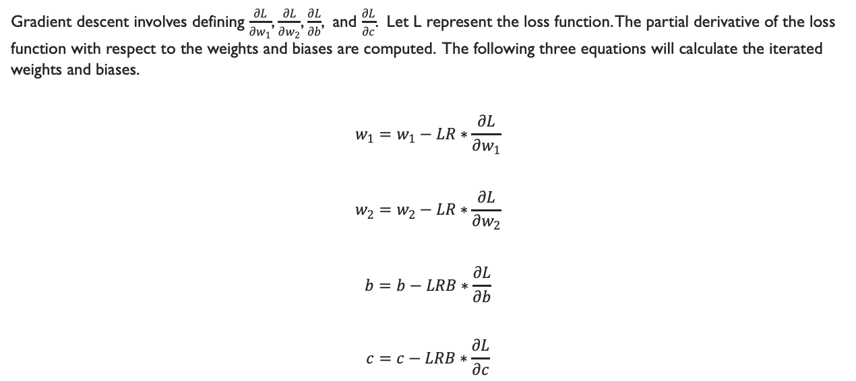
Backpropagation
Gradient descent involves defining $\frac{∂L}{∂w_{1}}$, $\frac{∂L}{∂w_{2}}$, $\frac{∂L}{∂b}$, and $\frac{∂L}{∂c}$. Let L represent the loss function. The partial derivative of the loss function with respect to the weights and biases are computed. The following three equations will calculate the iterated weights and biases.
$$w_{1}=w_{1}−LR∗\frac{∂L}{∂w_{1}}$$
$$w_{2}=w_{2}−LR∗\frac{∂L}{∂w_{2}}$$
$$b=b−LRB∗\frac{∂L}{∂b}$$
$$c=c−LRB∗\frac{∂L}{∂c}$$

Slide 13
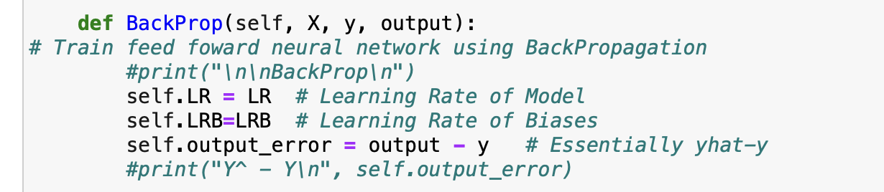
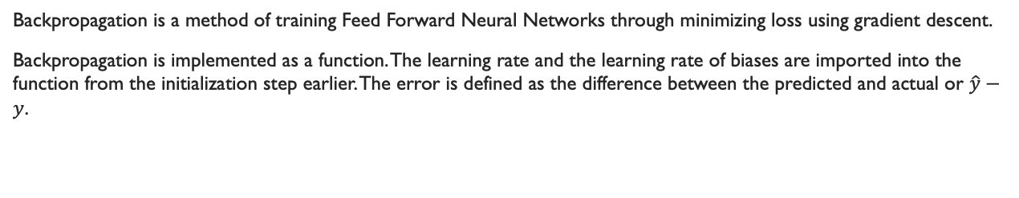
Backpropagation
Backpropagation is a method of training Feed Forward Neural Networks through minimizing loss using gradient descent.
Backpropagation is implemented as a function. The learning rate and the learning rate of biases are imported into the function from the initialization step earlier. The error is defined as the difference between the predicted and actual or $\hat{y}−y$.

Slide 14
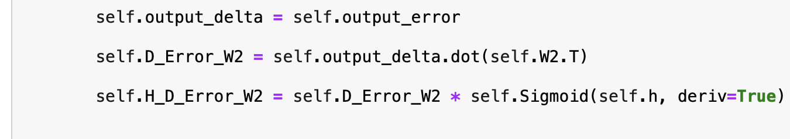
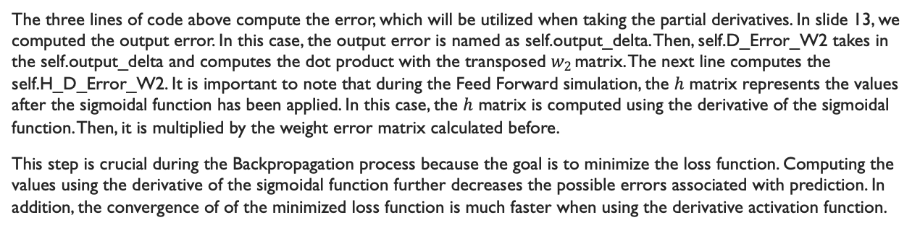
Backpropagation
The three lines of code above compute the error, which will be utilized when taking the partial derivatives. In slide 13, we computed the output error. In this case, the output error is named as self.output_delta. Then, self.D_Error_W2 takes in the self.output_delta and computes the dot product with the transposed $w_{2 }$matrix. The next line computes the self.H_D_Error_W2. It is important to note that during the Feed Forward simulation, the $h$ matrix represents the values after the sigmoidal function has been applied. In this case, the $h$ matrix is computed using the derivative of the sigmoidal function. Then, it is multiplied by the weight error matrix calculated before.
This step is crucial during the Backpropagation process because the goal is to minimize the loss function. Computing the values using the derivative of the sigmoidal function further decreases the possible errors associated with prediction. In addition, the convergence of of the minimized loss function is much faster when using the derivative activation function.

Slide 15
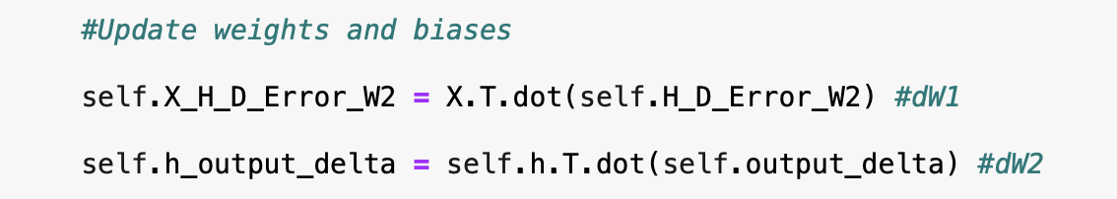
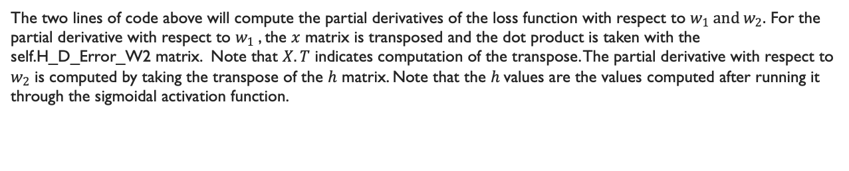
Backpropagation
The two lines of code above will compute the partial derivatives of the loss function with respect to $w_{1} and w_{2}.$ For the partial derivative with respect to $w_{1}$, the $x$ matrix is transposed and the dot product is taken with the self.H_D_Error_W2 matrix. Note that $X.T$ indicates computation of the transpose. The partial derivative with respect to $w_{2}$ is computed by taking the transpose of the $h$ matrix. Note that the $h$values are the values computed after running it through the sigmoidal activation function.

Slide 16
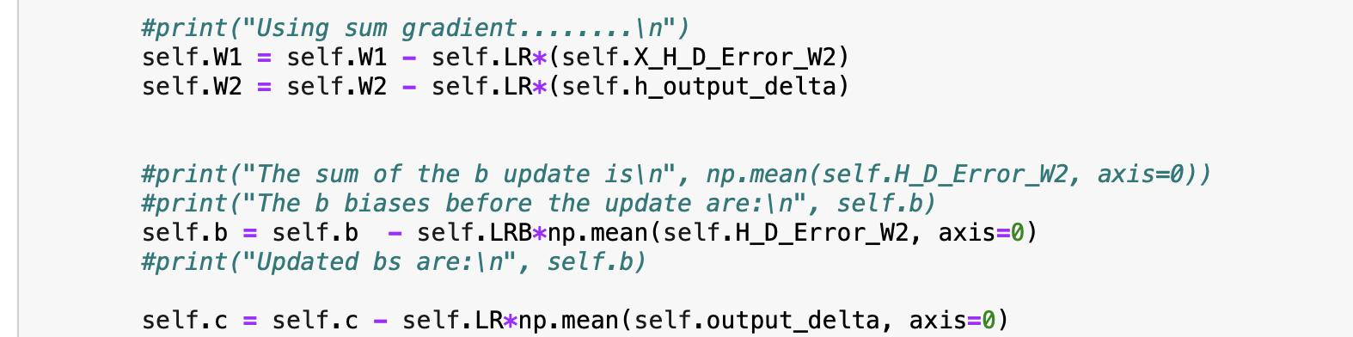
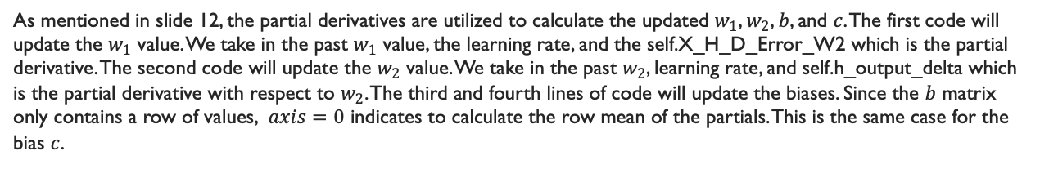
Backpropagation
As mentioned in slide 12, the partial derivatives are utilized to calculate the updated $w_{1}$, $w_{2}$, $b$, and $c$. The first code will update the $w_{1}$ value. We take in the past $w_{1}$ value, the learning rate, and the self.X_H_D_Error_W2 which is the partial derivative. The second code will update the $w_{2}$ value. We take in the past $w_{2}$, learning rate, and self.h_output_delta which is the partial derivative with respect to $w_{2}$. The third and fourth lines of code will update the biases. Since the $b$ matrix only contains a row of values, $axis=0$ indicates to calculate the row mean of the partials. This is the same case for the bias $c$.

Slide 17
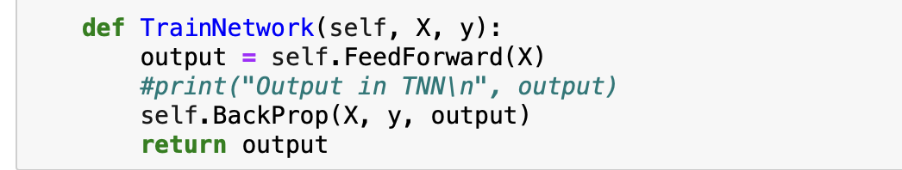
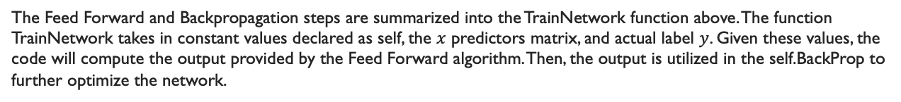
Train Neural Network
The Feed Forward and Backpropagation steps are summarized into the TrainNetwork function above. The function TrainNetwork takes in constant values declared as self, the $x$ predictors matrix, and actual label $y$. Given these values, the code will compute the output provided by the Feed Forward algorithm. Then, the output is utilized in the self.BackProp to further optimize the network.

Slide 18
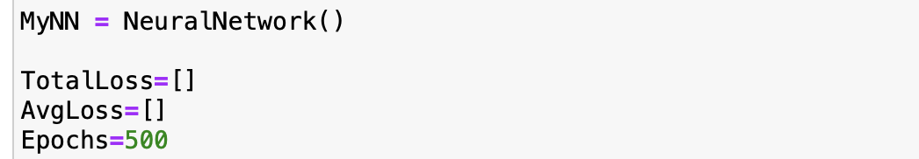
Evaluation through Epochs
During the iteration step, it is important to utilize the Neural Network computation provided in the past slides. The Neural Network object is named as MyNN, which will be attached to the lines of code that requires calling in the object. Since we are calculating the total loss and appending each total loss value, we must generate an empty matrix, which is represented as the brackets. The same process is applied to the average loss. In this simulation, the epochs is set to 500. Essentially, the epochs indicate the number of iterative runs.

Slide 19
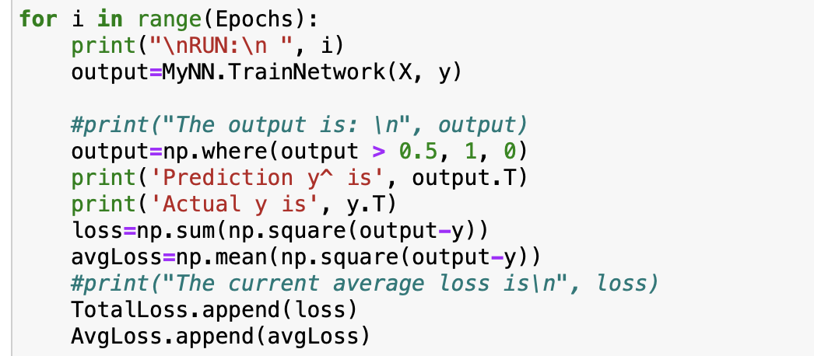
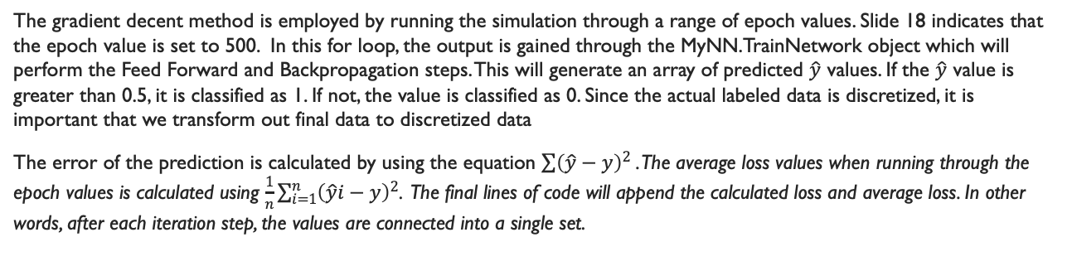
Iteration through Epochs
The gradient decent method is employed by running the simulation through a range of epoch values. Slide 18 indicates that the epoch value is set to 500. In this for loop, the output is gained through the MyNN.TrainNetwork object which will perform the Feed Forward and Backpropagation steps. This will generate an array of predicted $\hat{y}$ values. If the $\hat{y}$ value is greater than 0.5, it is classified as 1. If not, the value is classified as 0. Since the actual labeled data is discretized, it is important that we transform out final data to discretized data
The error of the prediction is calculated by using the equation $\sum{{\left(\hat{y}−y\right)}^{2}}$. The average loss values when running through the epoch values is calculated using $\frac{1}{n}\sum_{i=1}^{n}{{\left(\hat{y}i−y\right)}^{2}}$. The final lines of code will append the calculated loss and average loss. In other words, after each iteration step, the values are connected into a single set.

Slide 20
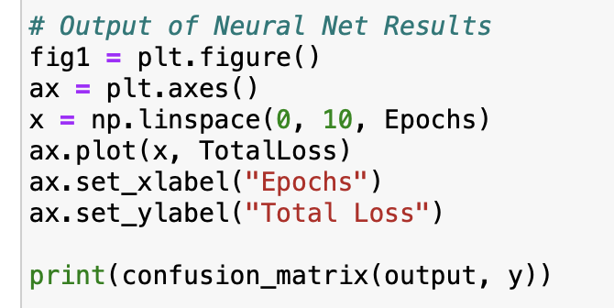
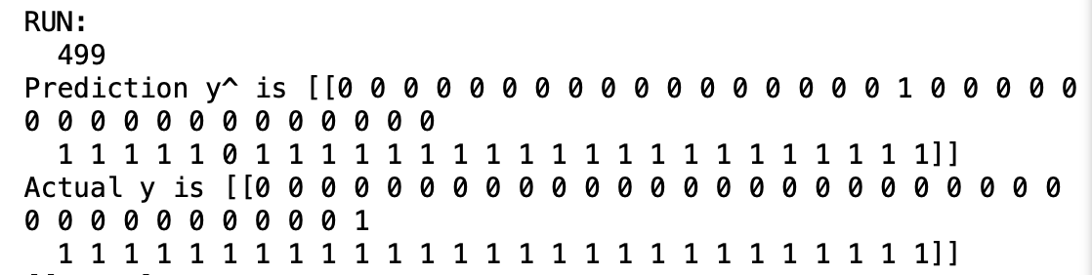
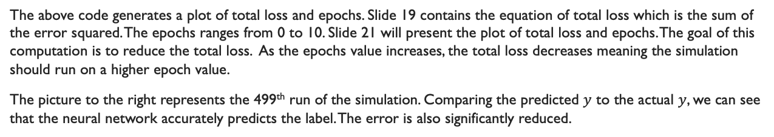
Neural Network results
The above code generates a plot of total loss and epochs. Slide 19 contains the equation of total loss which is the sum of the error squared. The epochs ranges from 0 to 10. Slide 21 will present the plot of total loss and epochs. The goal of this computation is to reduce the total loss. As the epochs value increases, the total loss decreases meaning the simulation should run on a higher epoch value.
The picture to the right represents the 499th run of the simulation. Comparing the predicted $y$ to the actual $y$, we can see that the neural network accurately predicts the label. The error is also significantly reduced.

Slide 21
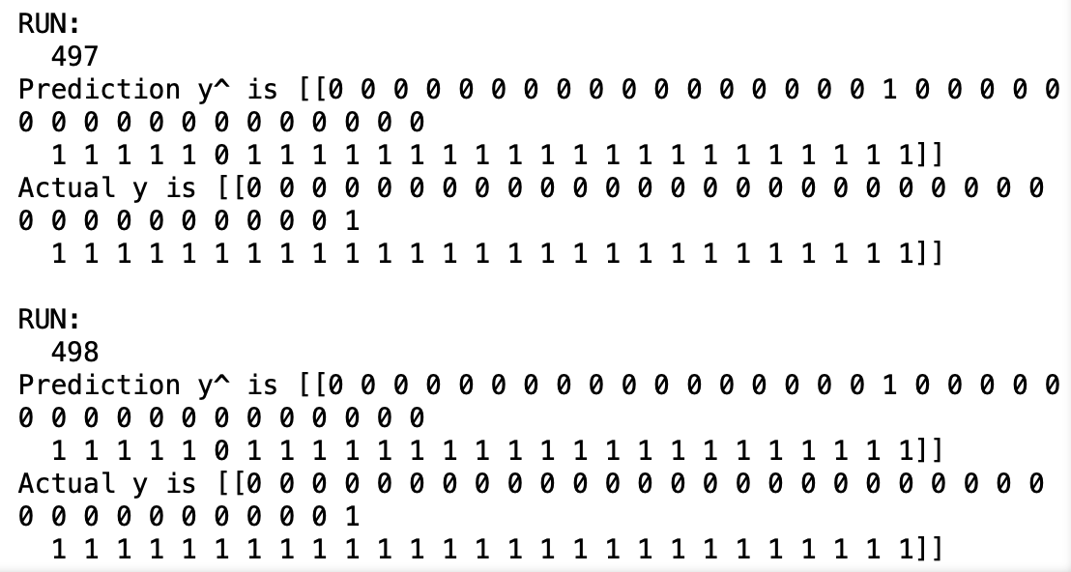
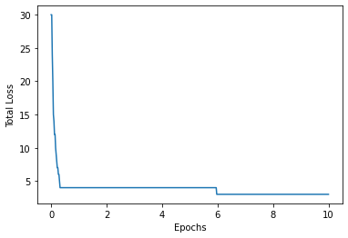
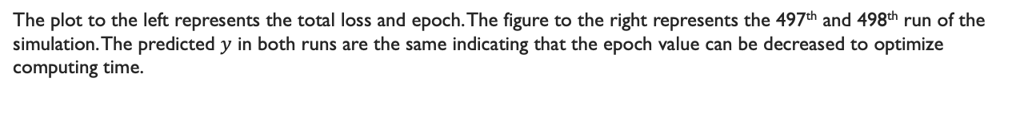
Total Loss and Epochs
The plot to the left represents the total loss and epoch. The figure to the right represents the 497th and 498th run of the simulation. The predicted $y$ in both runs are the same indicating that the epoch value can be decreased to optimize computing time.

Slide 22
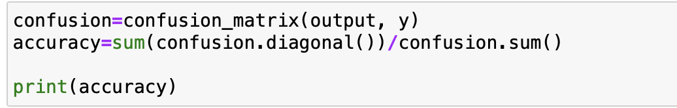
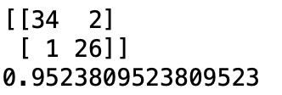
Confusion matrix and accuracy
To evaluate the accuracy and similarity of the neural network with the actual values, we are going to create a confusion matrix. Confusion matrix is a library under sklearn.metrics. The accuracy based on the confusion matrix is calculated by taking the ratio of the sum of the correct positive and negatives over the total sum of the matrix. The confusion matrix and accuracy is presented to the right. The accuracy of this process is around 95.23%.

